Slide 1
PREDICTION OF FACTORS THAT AFFECT CLICKS ON ADVERTISEMENT USING R
BY:
CHANDRIMA THAKUR

Slide 2
TABLE OF
CONTENTS
OBJECTIVES
DEPENDENT VARIABLE
COUNT OF VARIABLE
UNIVARIATE ANALYSIS
BIVARIATE ANALYSIS
SIGNIFICANT VARIABLES
INSIGNIFICANT VARIABLES
RESULTS OBTAINED
VARIABLE RELATIONSHIPS
BUSINESS RECOMENDATIONS

Slide 3
OBJECTIVE
A company launches their website and they spread the word to potential customers with the help of advertisement. This dataset consist of historical website data by users with different countries located in different cities.
In this case study we are provided with data having 6657 rows and14 columns which are VistID, Time_Spent ,Age , Avg_Income ,Internet_Usage ,Ad_Topic, Country_Name, City_code ,Male,Time_Period, Weekday ,Month,Year and Clicked.
We have to predict the factors that helps in generating more clicks in advertisement so that the company can generate more revenue.
Considering this objective, we are running a LOGISTIC REGRESSION on target/dependent variable CLICKED, to analyse the influence of several independent factors that affect CLICKED.

Slide 4
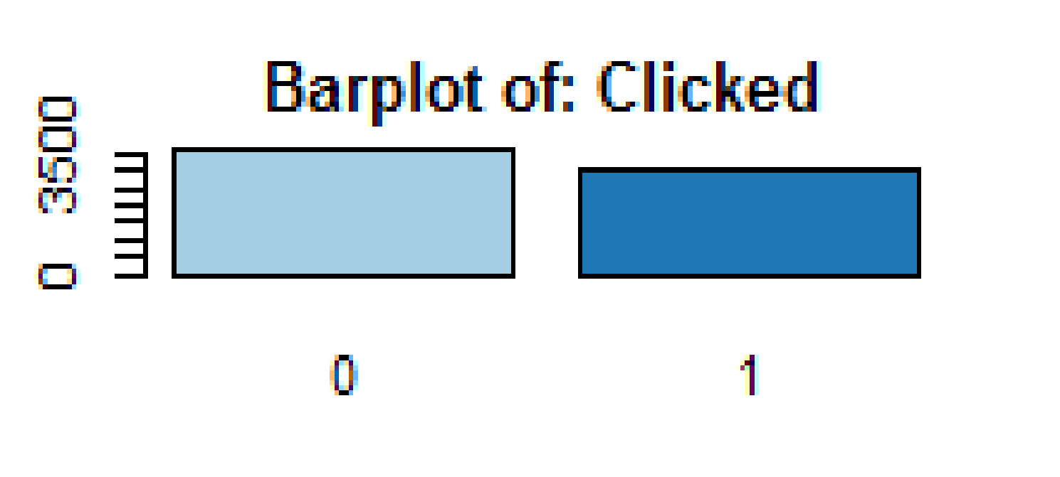
DEPENDENT
VARIABLE
The target variable for case-study is CLICKED.
It is a CATEGORICAL data consisting 0 and 1.
In Clicked,0 means not clicked and 1 means that user clicked the Ad

Slide 5
COUNT OF VARIABLES
There are total 14 variables and 6657 number of observations in this dataset.
The variables are VistID, Time_Spent ,Age , Avg_Income ,Internet_Usage ,Ad_Topic, Country_Name, City_code ,Male,Time_Period, Weekday ,Month,Year and Clicked.
There were no missing values and no outliers present in the dataset.
The variables VISITID, Time_Spent ,Age , Avg_Income ,Internet_Usage are continuous variables.
The variables Ad_Topic, Country_Name, City_code ,Male,Time_Period, Weekday ,Month, Year and Clicked are categorical variables.
The target variable of the dataset is Clicked.
The are variables that have strong relation as well as t has weak relation with target variable .

Slide 6
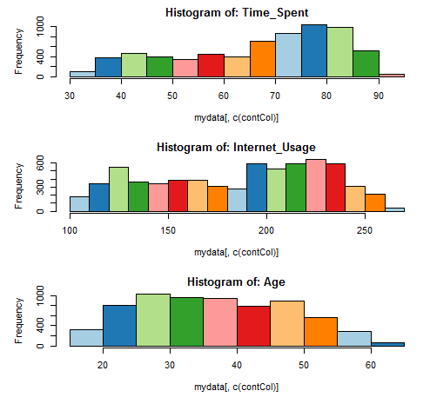
UNIVARIATE ANALYSIS: HISTOGRAM FOR CONTINUOUS VARIABLE

Slide 7
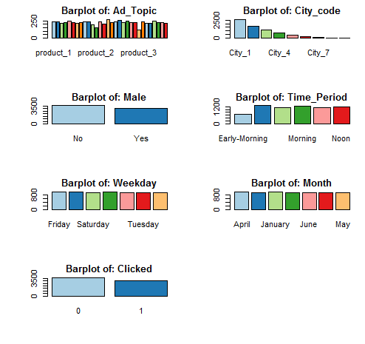
UNIVARIATE ANALYSIS: BARPLOT FOR CATEGORICAL VARIABLE

Slide 8
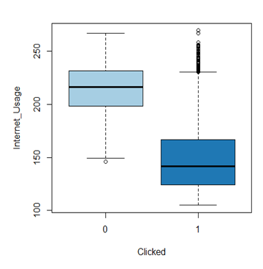
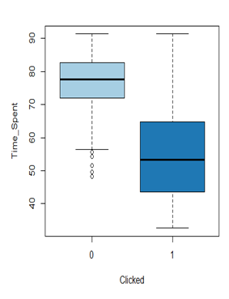
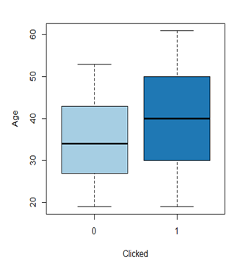
BIVARIATE ANALYSIS FOR CONTINUOUS DATA

Slide 9
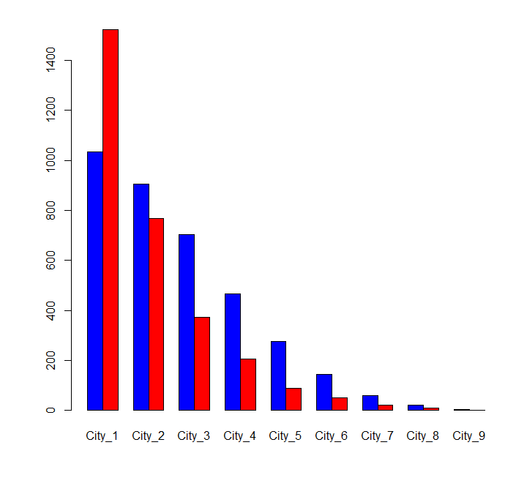
BIVARIATE ANALYSIS FOR CATEGORICAL DATA(CITY_CODE)
Here,
blue : clicked
red: not clicked.

Slide 10
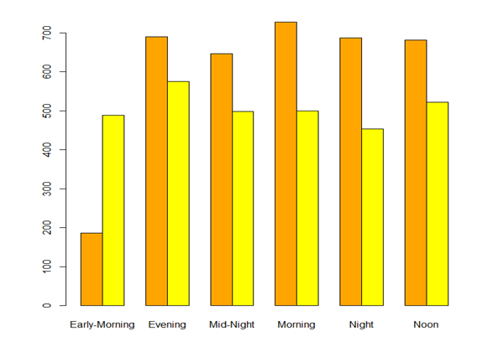
BIVARIATE ANALYSIS FOR CATEGORICAL DATA(TIME_PERIOD)
Here,
Orange:not clicked
Yellow :Clicked

Slide 11
SIGNIFICANT
VARIABLES
Time_spent
Internet_usage
Age
City_code
Time_period
INSIGNIFICANT
VARIABLES
VisitId
Avg_income
Male.
Weekday
Month
Year
Ad_topic

Slide 12
RESULTS OBTAINED
Accuracy : 92.24 %
P-Value [Acc > NIR] : < 2.2e-16
Balanced Accuracy : 0.9240
Sensitivity : 0.9116
Mcnemar's Test P-Value : 0.0004091
Neg Pred Value : 0.8902
Specificity : 0.9365
Pos Pred Value or Precision : 0.9494
Vif value for all variables <5 no multicollinearity

Slide 13
VARIABLE RELATIONSHIPS
Positive variables: Age(having positive co-efficient)
Negative Variables: Time_Spent,City_Code,Time_Period(having negative

Slide 14
ADVERTISEMENT SHOULD BE DISPLAYED MORE DURING THE EVENING TIME AND NOON TIME
ADVERTISEMENT TARGET THE AUDIENCE BETWEEN AGE GROUP 20-50 THUS SHOULD BE DESIGNED ACCORDING TO THE MIDDLE YOUTH TASTE
BUSINESS RECOMMENDATION
ADVERTISEMENT SHOULD BE LESS DISPLAYED IN THE CITIES WITH CITY_CODE:CITY_7,CITY_8,CITY_9
ADVERTISEMENT SHOULD BE DISPLAYED MORE IN CITIES WITH CITY_CODE:CITY_1,CITY_2,CITY_3
ADVERTISEMENT SHOULD BE DISPLAYED MORE TO PEOPLE WHO HAS MORE INTERNET USAGE

Slide 15
THANK YOU.

